Slide 1

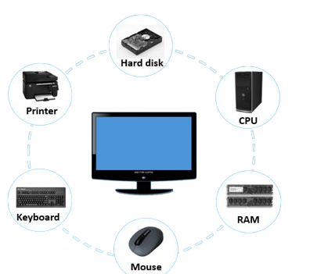
AtliQ technologies
Agenda:
Situation
Task
Action
Result

Slide 2
Situation:
Atliq Hardwares (imaginary company) is one of the leading computer hardware producers in India and well expanded in other countries too.
However, the management noticed that they do not get enough insights to make quick and smart data-informed decisions.
They want to expand their data analytics team by adding several junior data analysts. Tony Sharma, their data analytics director wanted to hire someone who is good at both tech and soft skills. Hence, he decided to conduct a SQL challenge which will help him understand both the skills.

Slide 3
Tasks:
Imagine yourself as the applicant for this role and perform the following task 1. Check ‘ad-hoc-requests.pdf’ - there are 10 ad hoc requests for which the business needs insights. 2. You need to run a SQL query to answer these requests. 3. The target audience of this dashboard is top-level management - hence you need to create a presentation to show the insights.

Slide 4
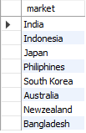
Actions :
Requests 1:
Provide the list of markets in which customer "Atliq Exclusive" operates its business in the APAC region.
Insight:
Atliq Exclusive operates its business in 8 International Market
In the APAC region.

Slide 5
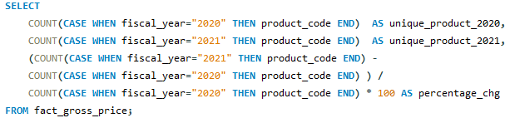

Requests 2:
What is the percentage of unique product increase in 2021 vs. 2020?
Insight:
Total of 36% Increase has occur from the past 1 year
In total number of Products.

Slide 6

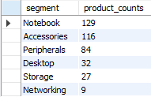
Requests 3:
Provide a report with all the unique product counts for each segment and sort them in descending order of product counts.
Insight:
In Segments, Notebook Top’s the table In Total Number Product
Which is 48% Higher then the rest of the Segment.
The second one is Accessories with 41%.
While the Networking come’s at bottom having Only 2%.

Slide 7
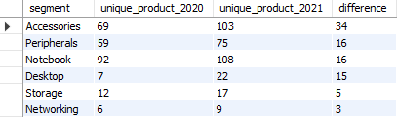
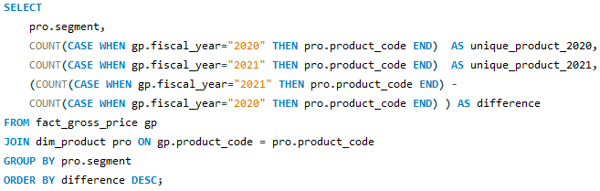
Requests 4:
Which segment had the most increase in unique products in 2021 vs 2020?
Insight:
Storage and Networking are the most Concurring In term’s
Of Product Increase.

Slide 8
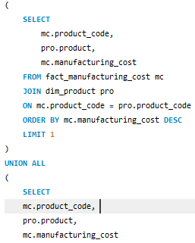

Requests 5:
Get the products that have the highest and lowest manufacturing costs.
Insight:
Above are the 2 Products With highest and lowest manufacturing costs.

Slide 9
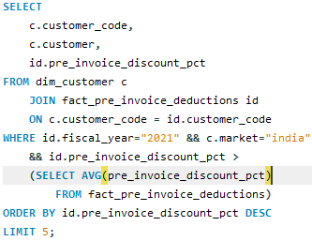
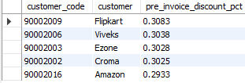
Requests 6:
Generate a report which contains the top 5 customers who received an average high pre_invoice_discount_pct for the fiscal year 2021 and in the Indian market.
Insight:
Top 5 customer Who have receive discount Greater then the
Average.

Slide 10
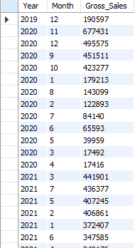
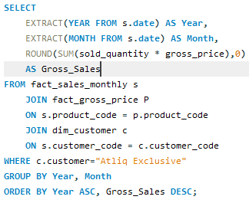
Requests 7:
Get the complete report of the Gross sales amount for the customer “Atliq Exclusive” for each month.
Insight:
Winter Season Is mostly more profitable then summer.

Slide 11
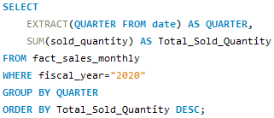

Requests 8:
In which quarter of 2020, got the maximum total_sold_quantity?
Insight:
1st And 4th Quarter has the most Quantity Sold.

Slide 12
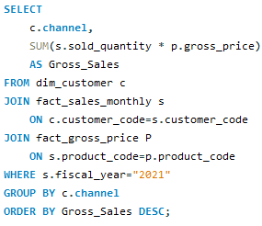

Requests 9:
Which channel helped to bring more gross sales in the fiscal year 2021 and the percentage of contribution?
Insight:
Retailer Channel bring the most Gross Sales in fiscal year 2021,
41.9M Approximately 270% more then the rest of the channels.

